Slide 1

Data Structures & Algorithms
Week-07

Slide 2
Week-07 Agenda
Hashing & Hash Tables

Slide 3
Hashing – Definition (Recap)
Hashing refers to the process of generating a fixed-size output from an input of variable size using the mathematical formulas known as hash functions.
This technique determines an index or location for the storage of an item in a data structure.

Slide 4
Hashing – Definition (Recap)
Hashing is a technique used to map data (keys) to a fixed-size value, known as a hash code or hash value.
The hash function transforms the input (or key) into an integer, which corresponds to the index in an array, called the hash table.
The purpose of hashing is to provide efficient searching, insertion, and deletion operations.

Slide 5
Hash Function (Recap)
A Hash Function takes a key and converts it into an index in a hash table.
The function should:
  Be deterministic (same key always gives the same index).
  Minimize collisions (two keys hashing to the same index).
  Distribute keys uniformly across the hash table.

Slide 6
Components of Hashing (Recap)
There are majorly three components of hashing:
Key: A Key can be anything string or integer which is fed as input in the hash function the technique that determines an index or location for storage of an item in a data structure.
Hash Function: The hash function receives the input key and returns the index of an element in an array called a hash table. The index is known as the hash index.
Hash Table: Hash table is a data structure that maps keys to values using a special function called a hash function. Hash stores the data in an associative manner in an array where each data value has its own unique index.

Slide 7
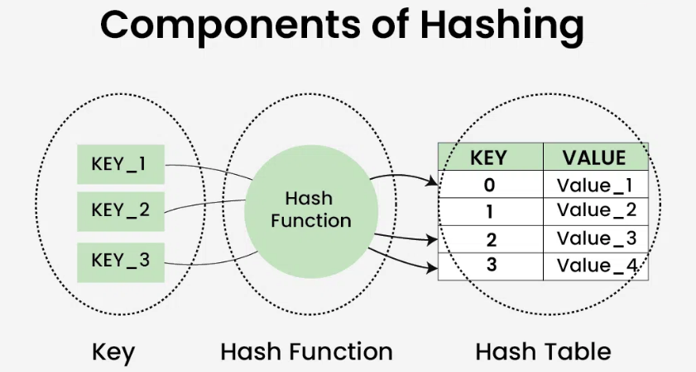
Components of Hashing (Recap)

Slide 8
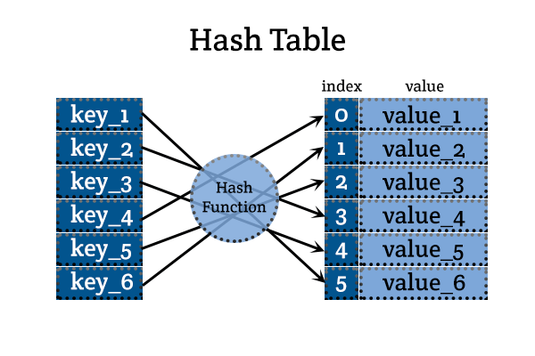
Hash Function (Recap)

Slide 9
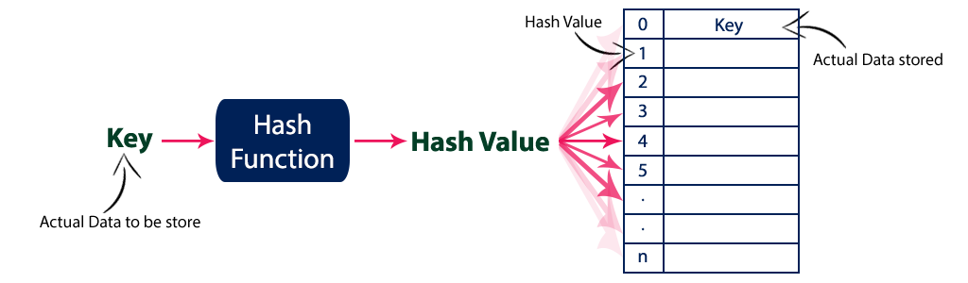
Hash Function (Recap)

Slide 10
Types of Hashing (Recap)
Direct Hashing
  Each key maps directly to an index in the hash table.
  Only feasible when the key space is small.
Modulo-Division Hashing
  A popular method where the key is divided by the table size and the remainder is used as the index.
  Example: For key 25 and table size 10, index = 25 % 10 = 5.

Slide 11
Hash Table Data Structure
A Hash table is defined as a data structure used to insert, look up, and remove key-value pairs quickly.
It operates on the hashing concept, where each key is translated by a hash function into a distinct index in an array.
The index functions as a storage location for the matching value. In simple words, it maps the keys with the value.

Slide 12
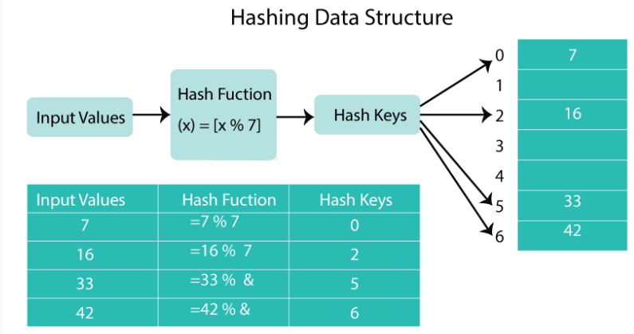
How Hashing Works?

Slide 13
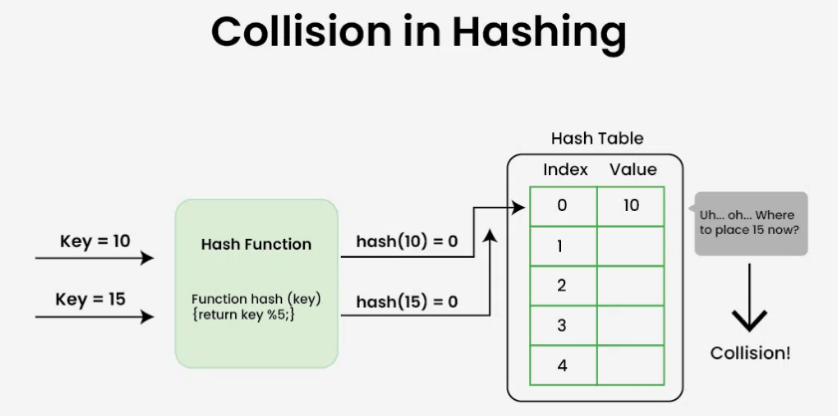
Collision in Hashing
Collisions happen when two or more keys point to the same array index.
Chaining, open addressing, and double hashing are a few techniques for resolving collisions.

Slide 14
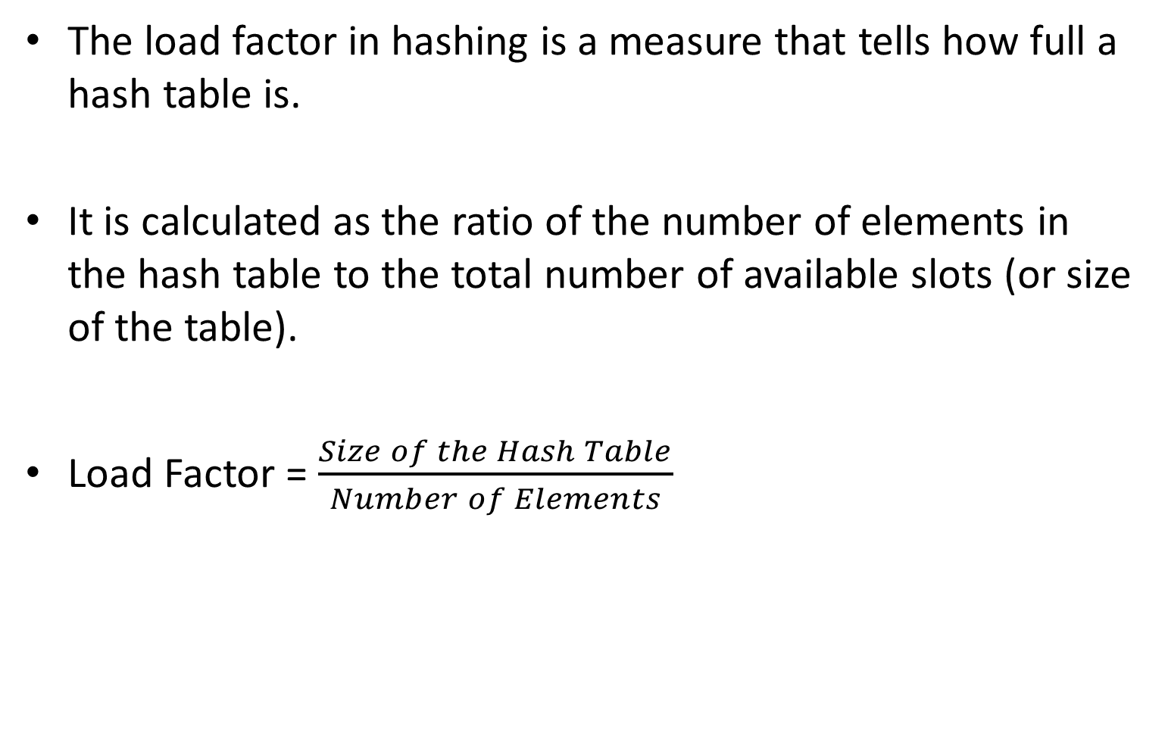
Load Factor
The load factor in hashing is a measure that tells how full a hash table is.
It is calculated as the ratio of the number of elements in the hash table to the total number of available slots (or size of the table).
Load Factor = $\frac{Size of the Hash Table}{Number of Elements}$​

Slide 15
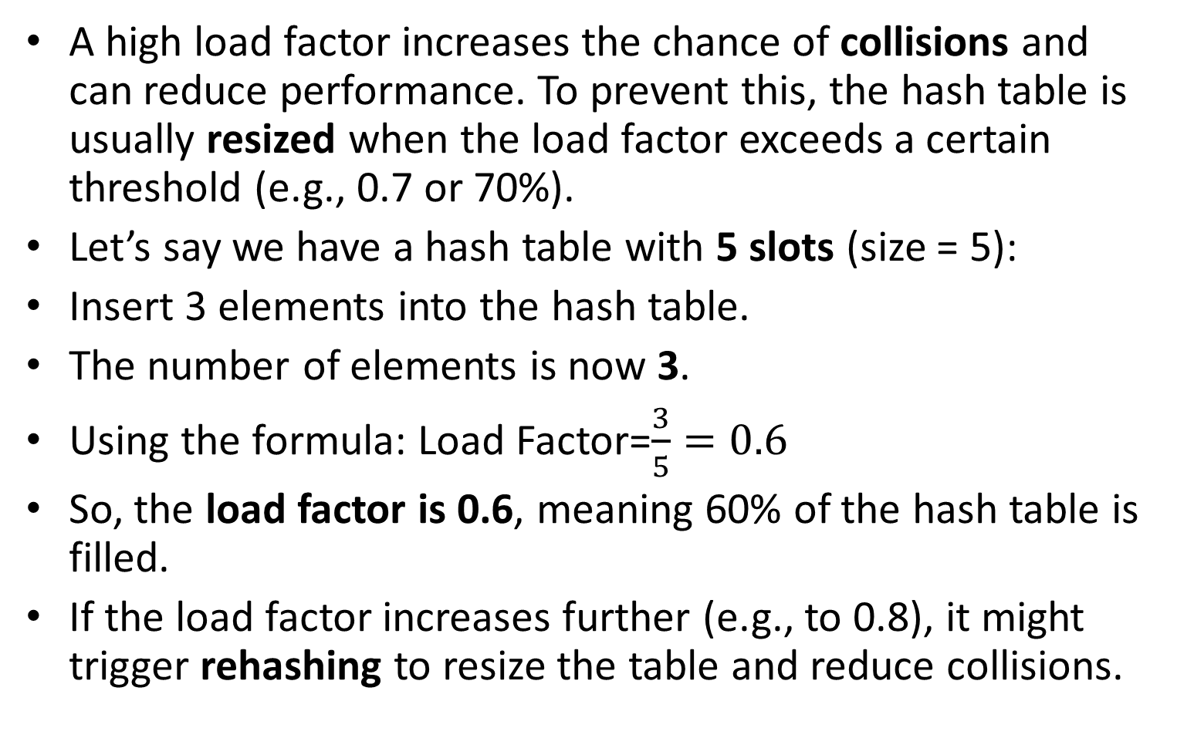
Load Factor
A high load factor increases the chance of collisions and can reduce performance. To prevent this, the hash table is usually resized when the load factor exceeds a certain threshold (e.g., 0.7 or 70%).
Let’s say we have a hash table with 5 slots (size = 5):
Insert 3 elements into the hash table.
The number of elements is now 3.
Using the formula: Load Factor=$\frac{3}{5}=0.6$
So, the load factor is 0.6, meaning 60% of the hash table is filled.
If the load factor increases further (e.g., to 0.8), it might trigger rehashing to resize the table and reduce collisions.

Slide 16
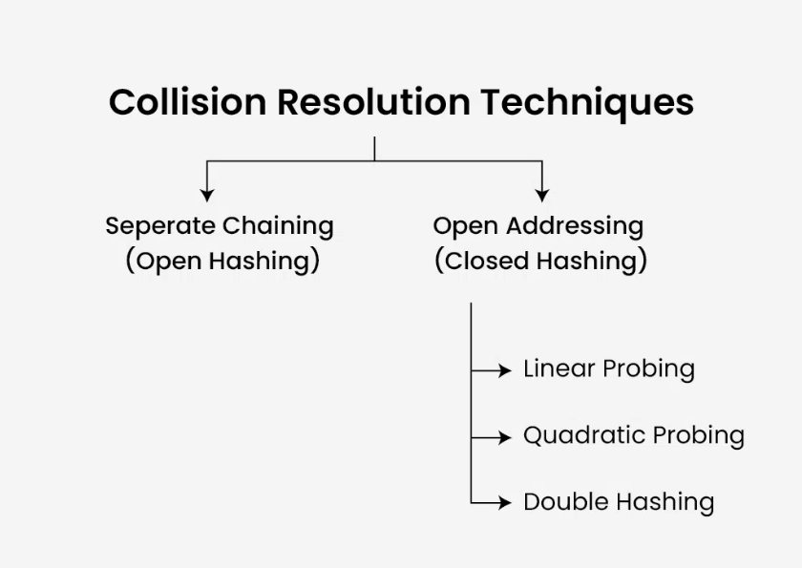
Collison Resolution Techniques

Slide 17
Open Hashing (Separate Chaining)
Definition: A collision resolution method where each bucket in the hash table holds a linked list (or chain) of elements.
How it works: When multiple elements hash to the same index, they are stored in the linked list at that index.
Key point: The table size does not limit the number of elements at a given index.
Example: If keys 5 and 15 both hash to index 0, the linked list at index 0 will hold both keys.

Slide 18
Open Hashing (Separate Chaining)
In separate chaining, a linked list of objects that hash to each slot in the hash table is present.
Two keys are included in the linked list if they hash to the same slot.
This method is rather simple to use and can manage several collisions.

Slide 19
Open Hashing (Open Addressing)
Collisions are handled by looking for the following empty space in the table.
If the first slot is already taken, the hash function is applied to the subsequent slots until one is left empty.
There are various ways to use this approach, including double hashing, linear probing, and quadratic probing

Slide 20
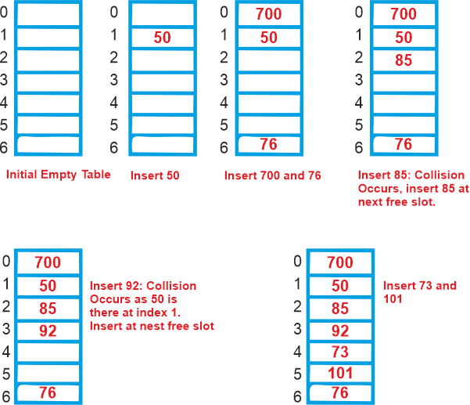
Collision Resolution Techniques
Open Addressing:
Let's use "key mod 7" as a simple hash function with the following keys: 50, 700, 76, 85, 92, 73, 101.

Slide 21
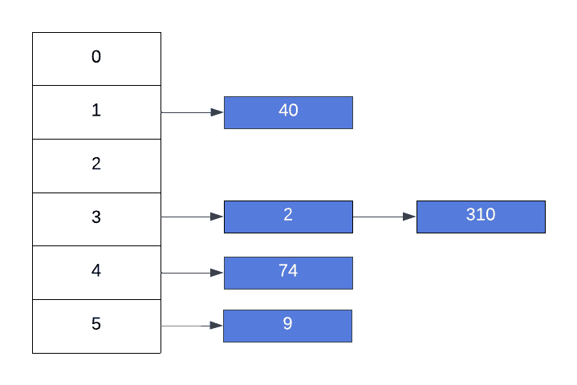
Collision Resolution Techniques
Separate Chaining:

Slide 22
Closed Hashing (Open Addressing)
Definition: A collision resolution method where all elements are stored within the hash table itself, with no external data structures like linked lists.
How it works: When a collision occurs, the element is placed in another slot in the table based on a probing strategy (e.g., linear probing, quadratic probing, etc.).
Key point: No linked lists; all elements must occupy slots in the hash table itself.
Example: If index 3 is occupied, the element is placed in another slot found using a probing method.

Slide 23
Linear Probing
Definition: A type of open addressing where collisions are resolved by checking the next available slot in a sequential manner.
How it works: If the current index is full, check the next index (i.e., index + 1), and keep moving sequentially until an empty slot is found.
Key point: Simple but can lead to clustering (many consecutive occupied slots).
Example: If key 12 hashes to index 4, but it’s full, check index 5, then index 6, and so on.

Slide 24
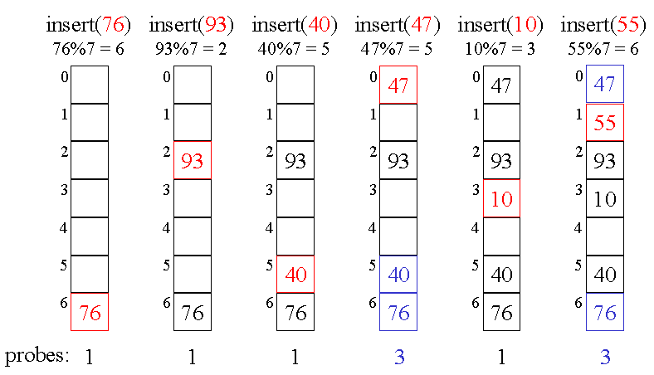
Linear Probing

Slide 25
Quadratic Probing
Definition: A collision resolution strategy where the interval between probes increases quadratically (e.g., by 1, 4, 9, etc.).
How it works: If the current index is full, check indices calculated by adding squared offsets (e.g., index + 1², index + 2², etc.).
Key point: Reduces clustering compared to linear probing, but may lead to secondary clustering.
Example: If index 4 is full, check index 4 + 1² = 5, then 4 + 2² = 8, and so on.

Slide 26
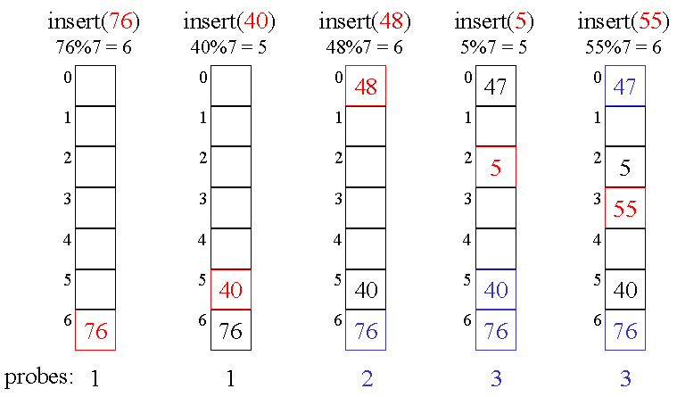
Double Hashing

Slide 27
Double Hashing
Definition: A collision resolution strategy where a second hash function is used to calculate the probe step size, providing a more diverse probing sequence.
How it works: When a collision occurs, a second hash function is applied to the key, and the result determines how far to move to the next slot.
Key point: Reduces clustering and provides better distribution than linear or quadratic probing.
Example: If key 17 hashes to index 2 and a collision occurs, use a second hash function (e.g., 7 - (key % 7)) to determine the next slot to check.

Slide 28
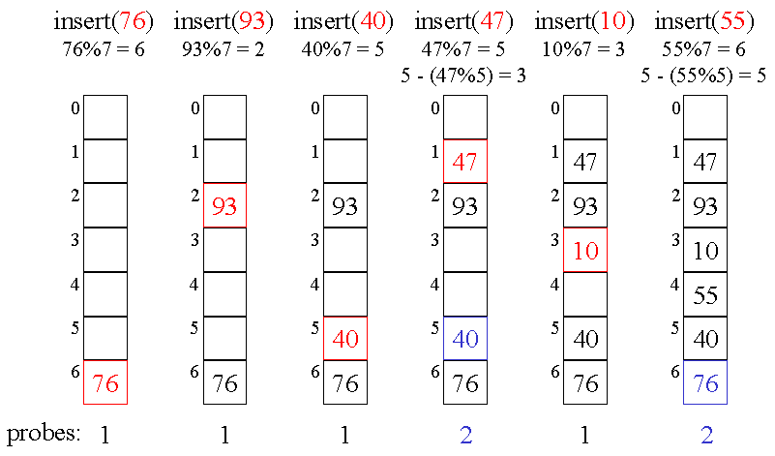
Double Hashing

Slide 29


